Slide 1
AUTHORING SKILLS ACROSS PLATFORMS: Creating Varieties of Quiz Formats in Different LMS Platforms
(Edmodo, Google Classroom/Form, Quizziz, Etc.)*
Rahman Hakim
John Pahamzah
University of Sultan Ageng Tirtayasa
*Presented on ICELLA 2021,
International Conference on Education, Language, Literature, ad Arts
ULM, September 10-11, 2021

Slide 2
AUTHORING TOOLS
Authoring tools allow teachers to select the best course content and then do the hard work for them. It would help if they used an authoring tool to host it in the cloud, whether they deliver via a centralized app embedded in an existing LMS

Slide 3
In the 1990s, the University of Victoria sponsored the development of a set of templates that came to be known as Hot Potatoes that is now distributed free for educators by Half-Baked Software.
https://hotpot.uvic.ca/

Slide 4
The different templates allow foreign language teachers to create multiple-choice exercises, word-entry exercises (single word, phrase, string, or open-ended), crossword puzzles, cloze (fill-in) exercises, jumble-word exercises, and mix-and-match exercises (Black, 2008).

Slide 6
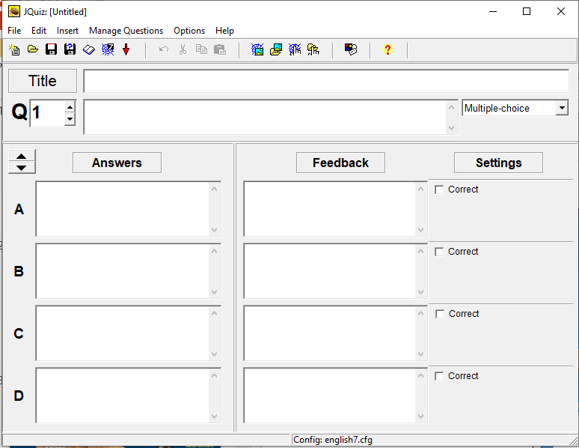
JQuiz exercise
Add title
Add feedback such as “Welldone” if it is correct, or “Try again if it is wrong
Add question
Add option
Set the correct answer

Slide 7
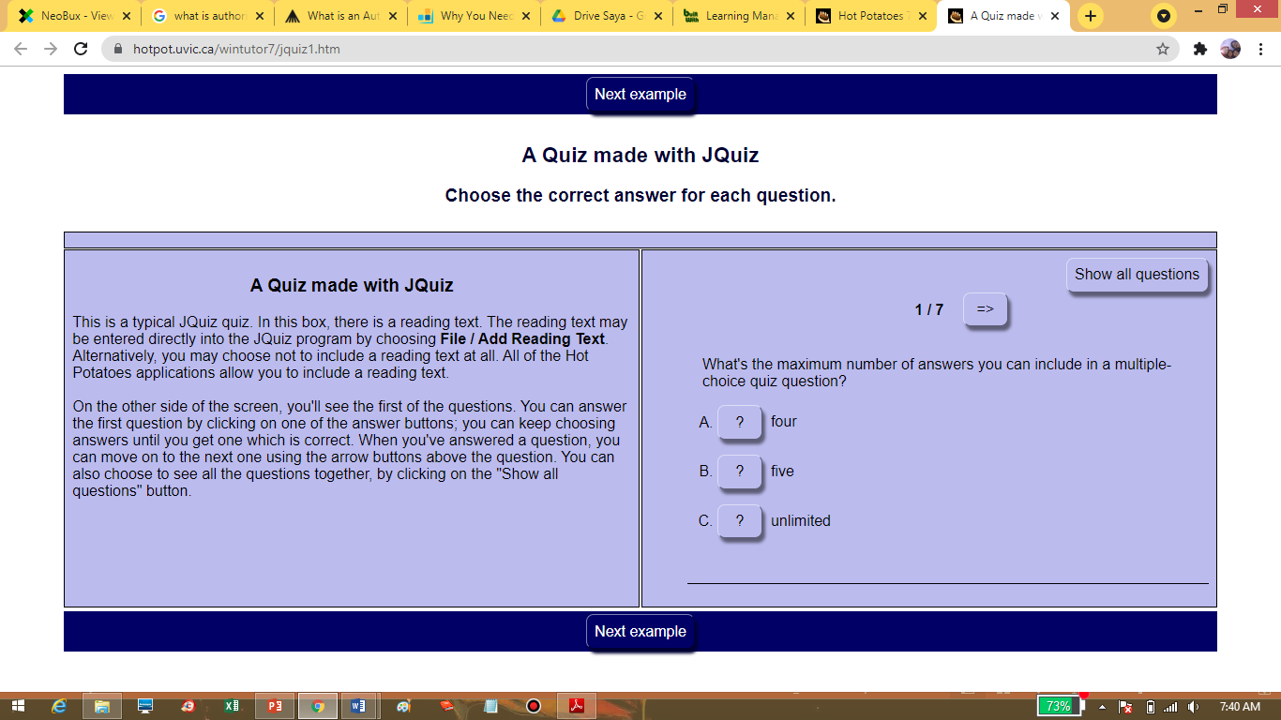

Slide 8
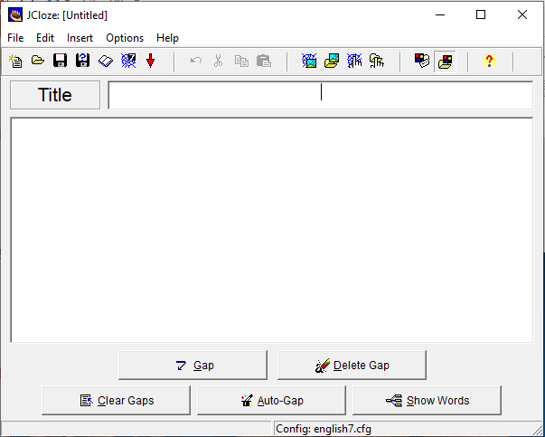
JCloze
Gap-fill exercise
Add title
Add text

Slide 9
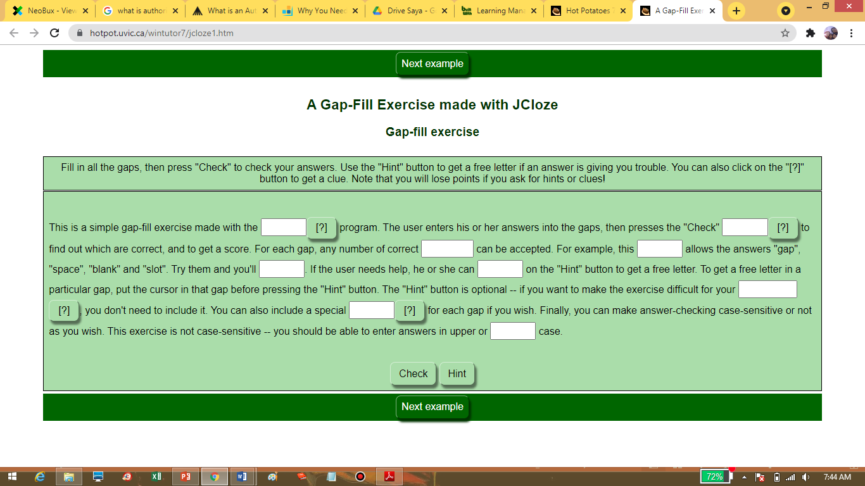

Slide 10
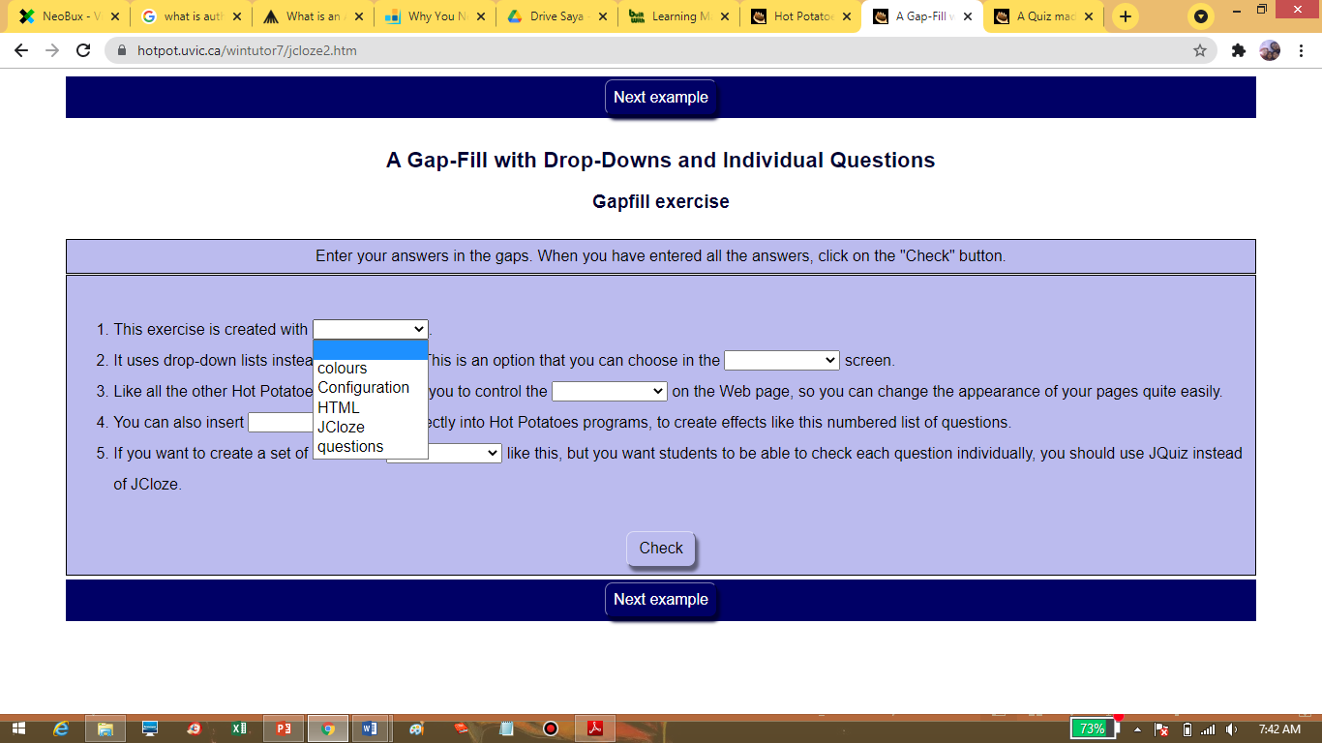

Slide 11
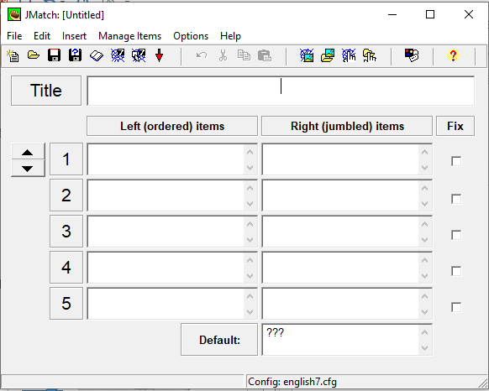
JMATCH
(MATCHING EXERCISES)
Add title
Add the correct match
Add question, statement, concept, picture, etc.

Slide 12
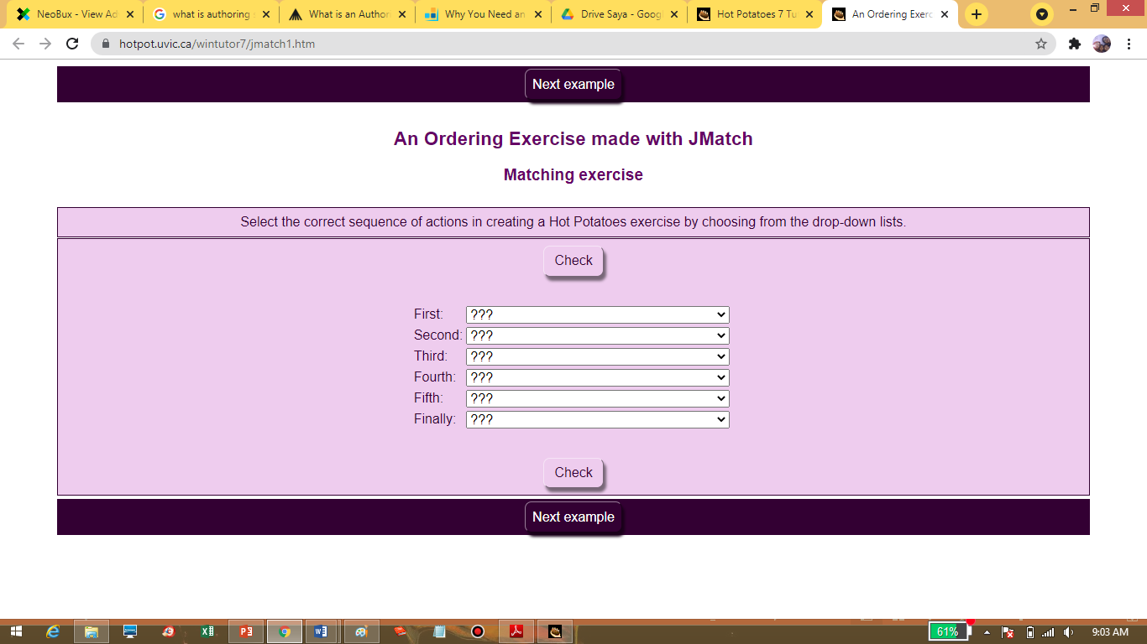

Slide 13
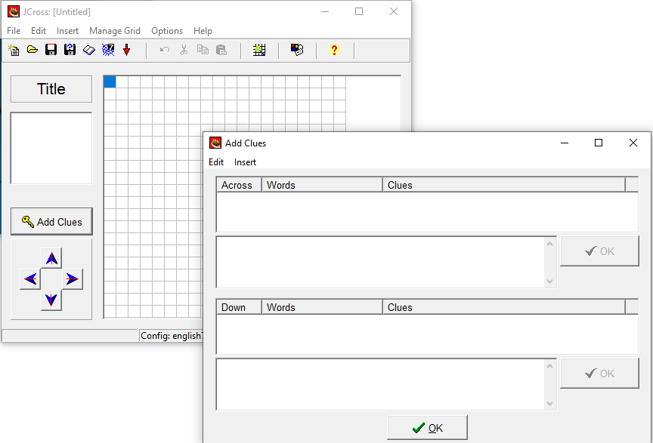
JCROSS
CROSSWORD
Add words (vertically/horizontally)
Add title
Provide clue for each word

Slide 14
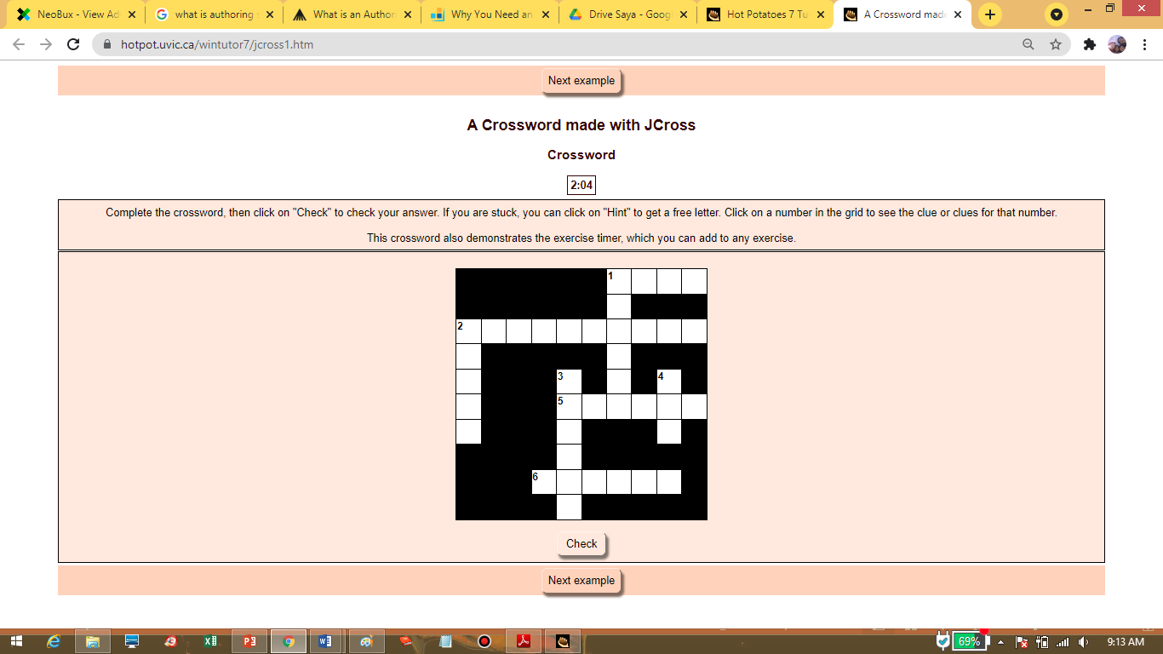

Slide 15
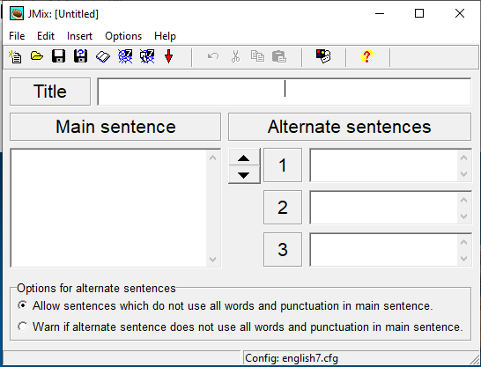
JMIX
(JUMBLE EXERCISES)
Add title
Add the sentence (separate each word by enter)
Put possible correct answer

Slide 16
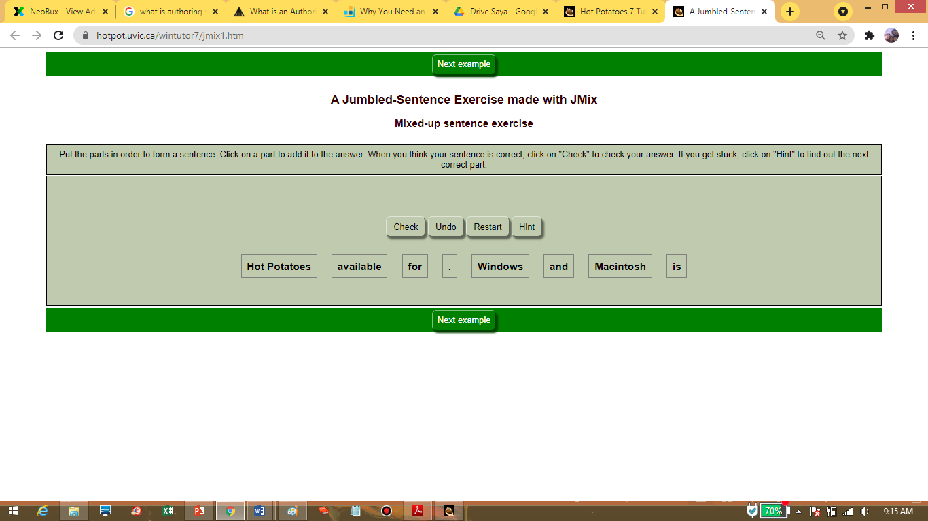

Slide 17
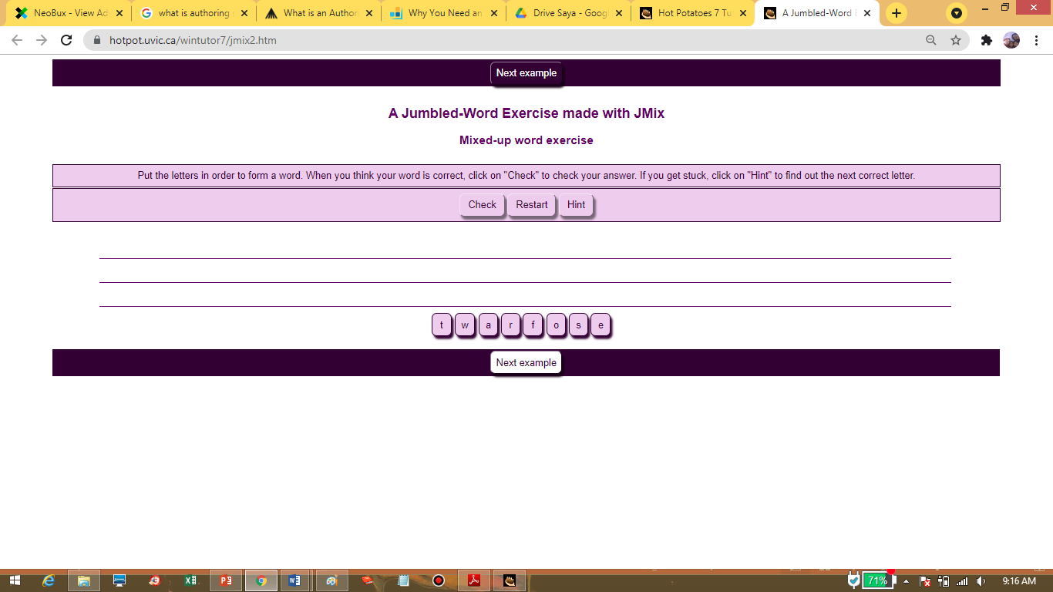

Slide 18
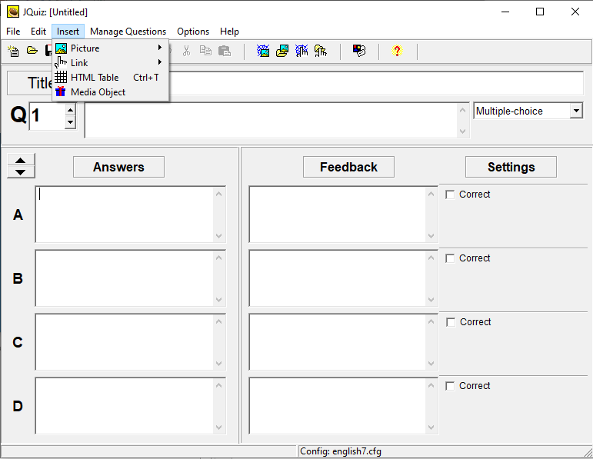
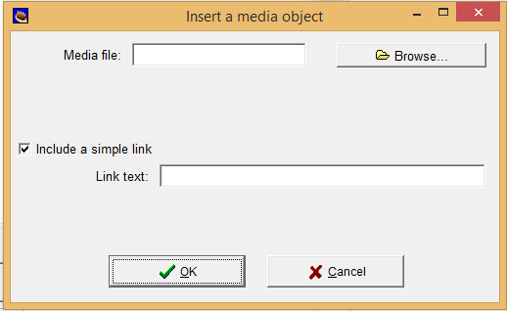
Add picture and media (audio, video, or flash object)
add picture
Add audio/video

Slide 19
How are the features provided on other platform?
Edmodo, Quizzes, Googleform, etc

Slide 21
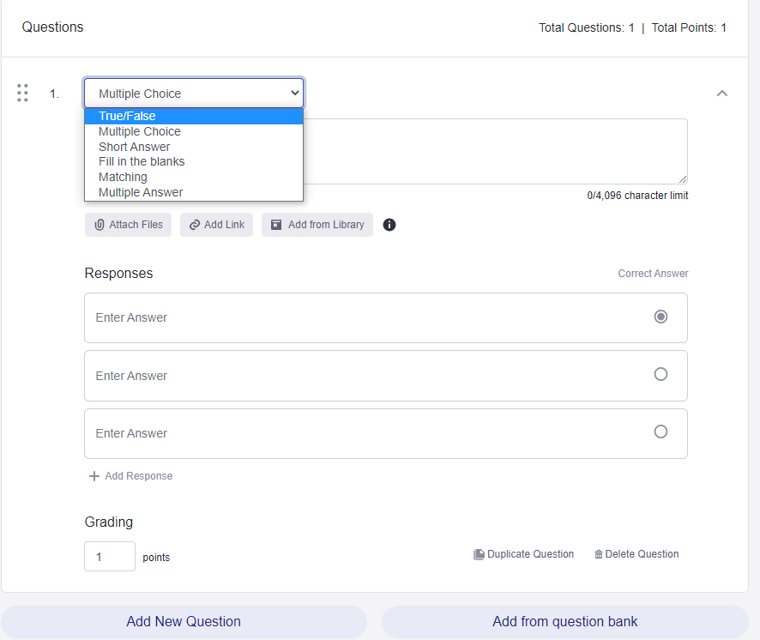
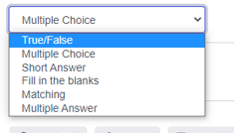

Slide 22
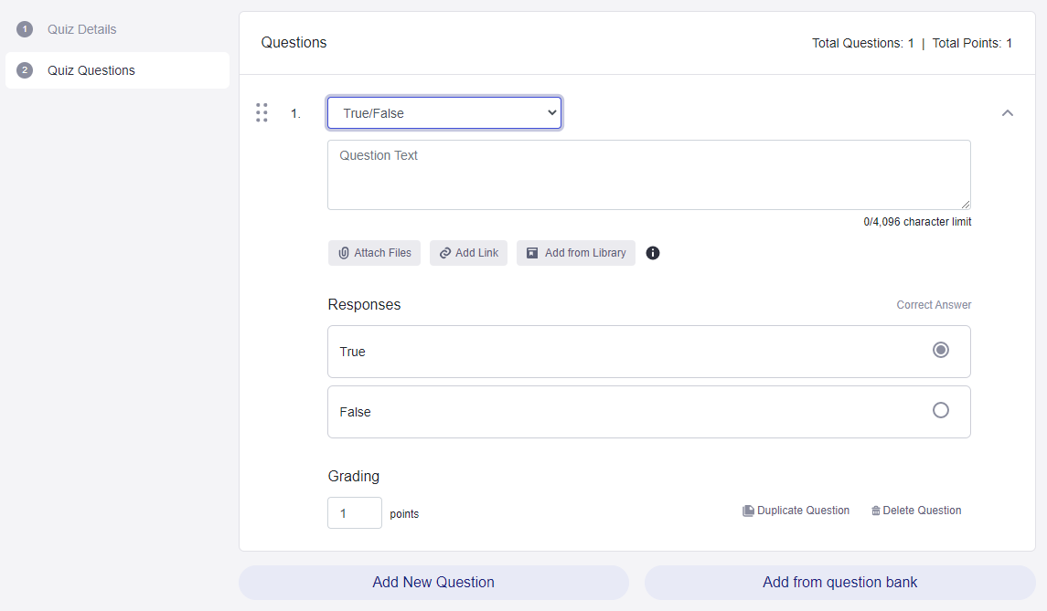
TRUE-FALSE EXERCISE
add question
Choose true/false

Slide 23
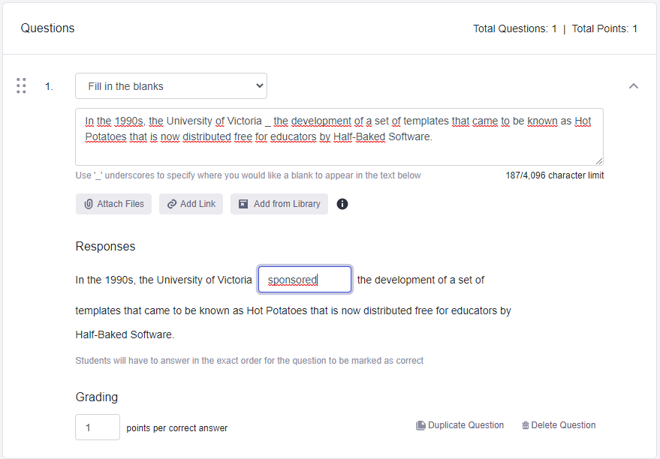
FILL IN THE BLANKS EXERCISE
On keyboard: Shift+underscore (_)
Answer key

Slide 24
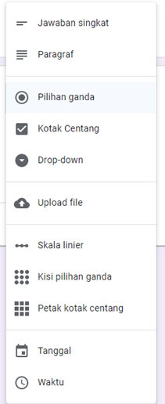
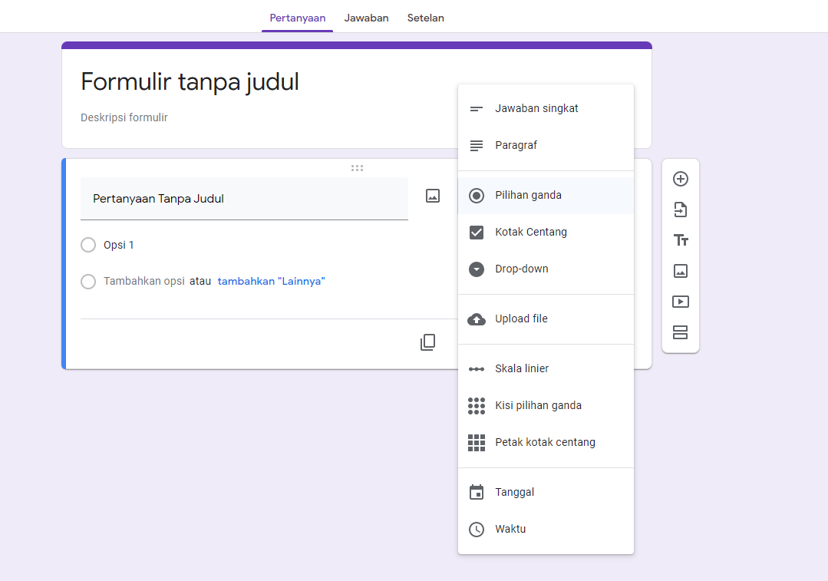
QUIZ FORMATS IN GOOGLEFORM

Slide 25
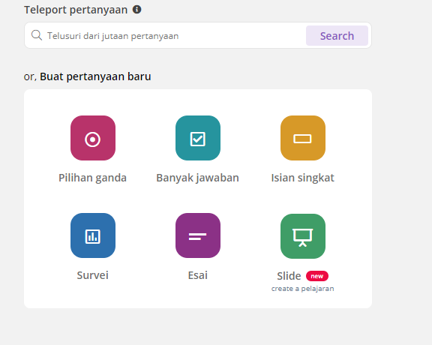
QUIZ FORMATS IN QUIZZIZ

Slide 26
How do the teachers add media (audio or video files) for the listening quiz in the platforms?

Slide 27
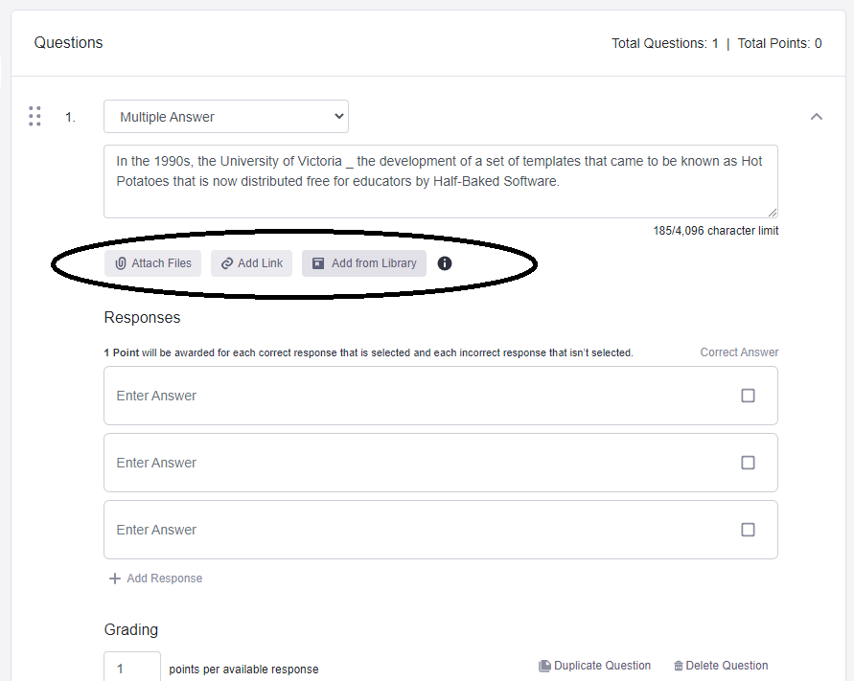
Add video

Slide 29
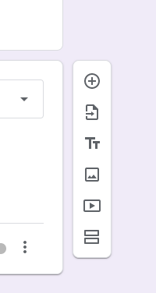
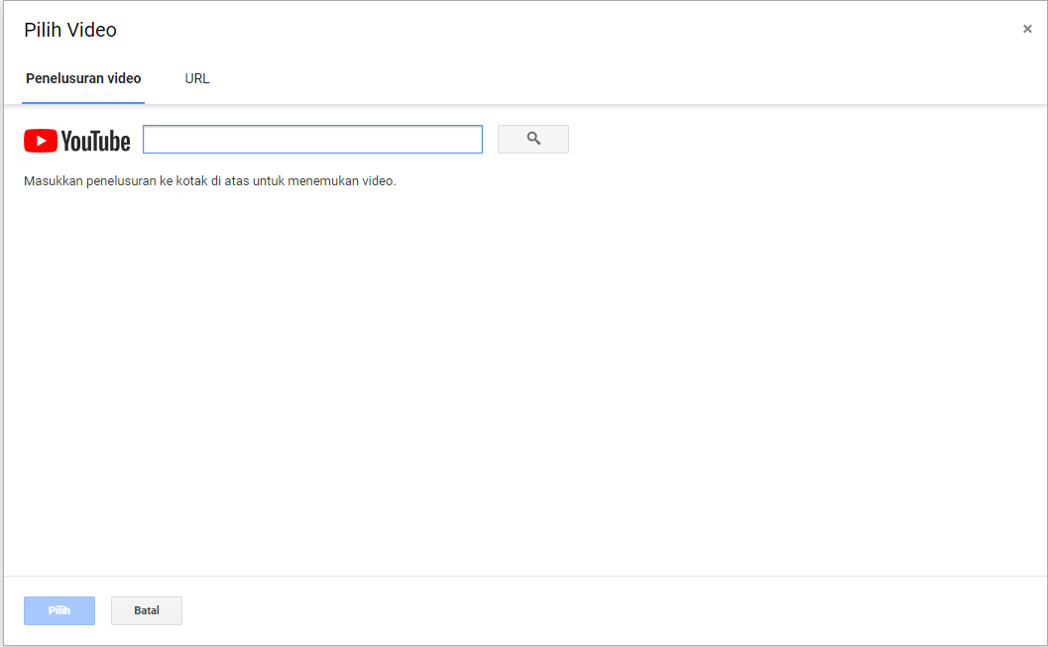
Add video

